Slide 1
Lines Detection with Hough Transform
Lines Detection with Hough Transform
M.Jahanzaib(BCSF17A554)
Arzoo Khalil(BCSF17A547)

Slide 2
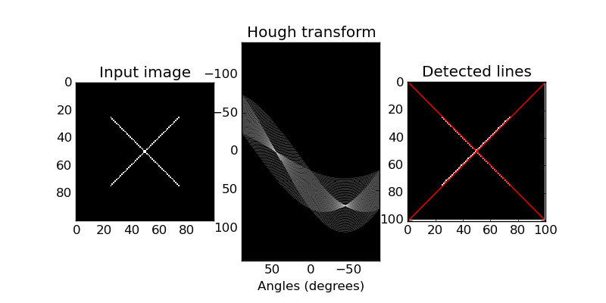
Hough Transformation
The Hough transform is a feature extraction technique used in image analysis, computer vision, and digital image processing. The purpose of the technique is to find imperfect instances of objects within a certain class of shapes by a voting procedure

Slide 3
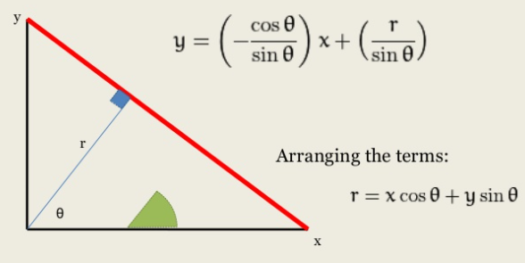
How It Works
The Hough technique is particularly useful for computing a global description of a features. The motivating idea behind the Hough technique for line detection is that each input measurement (e.g. coordinate point) indicates its contribution to a globally consistent solution

Slide 4
The Algorithm
Decide on the range of ρ and θ. Often, the range of θ is [ 0, 180 ] degrees and ρ is [ -d, d ] where d is the length of the edge image’s diagonal. It is important to quantize the range of ρ and θ meaning there should be a finite number of possible values.
Create a 2D array called the accumulator representing the Hough Space with dimension (num_rhos, num_thetas) and initialize all its values to zero.
Perform edge detection on the original image. This can be done with any edge detection algorithm of your choice.
For every pixel on the edge image, check whether the pixel is an edge pixel. If it is an edge pixel, loop through all possible values of θ, calculate the corresponding ρ, find the θ and ρ index in the accumulator, and increment the accumulator base on those index pairs.
Loop through all the values in the accumulator. If the value is larger than a certain threshold, get the ρ and θ index, get the value of ρ and θ from the index pair which can then be converted back to the form of y = ax + b.

Slide 5
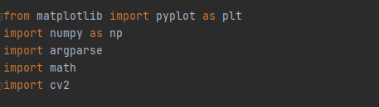
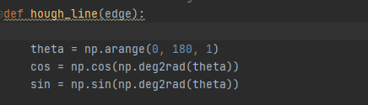

The Code
All the necessary imports
Calculating ‘cos’
& ‘sin’ values to improve code efficiency
Generating an accumulator matrix to store the values

Slide 6

The Code
Reading image and converting to greyscale and detecting edges using “Canny Edge Detection”
Canny Edge detection
The Canny edge detector is an edge detection operator that uses a multi-stage algorithm to detect a wide range of edges in images. It was developed by John F. Canny in 1986.

Slide 7
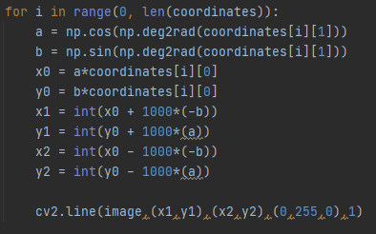


The Code
Line Equation to draw the lines
Thresholding some high values and then drawing lines
Threshold to get edges pixel location (x,y)

Slide 8

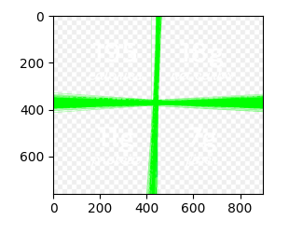
Line Detection
Original
Result

Slide 9
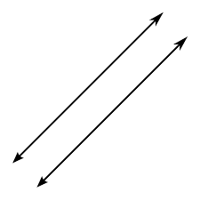
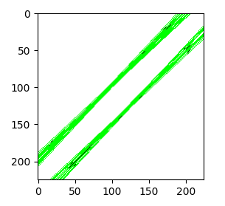
Line Detection
Original
Result

Slide 10
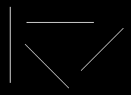
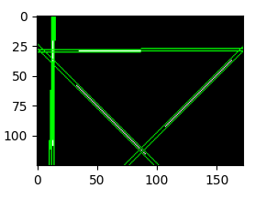
Line Detection
Original
Result

Slide 11
Resources
https://towardsdatascience.com/lines-detection-with-hough-transform-84020b3b1549 https://docs.opencv.org/master/d9/db0/tutorial_hough_lines.html https://www.slideshare.net/UpekhaVandebona/line-detection https://docs.opencv.org/master/da/d22/tutorial_py_canny.html https://www.slideshare.net/vaibhavvpatil/linear-hough-transform https://www.slideshare.net/NirjhorerSopnovongo/hough-transform-by-mdnazmul-islam https://towardsdatascience.a/lines-detection-with-hough-transform-84020b3b1549 https://github.com/Hank-Tsou/Hough-Transform-Line-Detection/blob/master/hough_line_transform.py

Slide 12
Thank You…!!!
“It's going to be interesting to see how society deals with artificial intelligence, but it will definitely be cool.” —Colin Angle

